Slide 1
Algothon – Team 19
Supply Chain Analysis

Slide 2

Supply Chain effects.
Datasets – China Supply Chain, China stocks.
Idea:
Choose a company which has publicly listed stocks – parent company
Use the supply chain network to find out the companies which this depends on – children companies.
Use the time series of children company stock prices to analyse correlations to the parent company
Predict time series of the parent company using time series of the children – the lag between the time series can be adjusted – i.e. direct dependencies of the parent company will be affected by the time series at different lags of the children.

Slide 3
Markov Regime
Depending on economic growth and slowdown – different effects of the children on the parents will be observed
When in slowdown – if the supplier is doing well/badly what’s the effect on parent.
When in growth – are the parents and supplier positively correlated?
Use Markov Chain with state space {0,1} – representing slowdown and growth – this is non-homogeneous – i.e. depends on time, and the transition matrix will depend on covariates – indicators of economic growth/slowdown – government spending, unemployment etc.

Slide 4
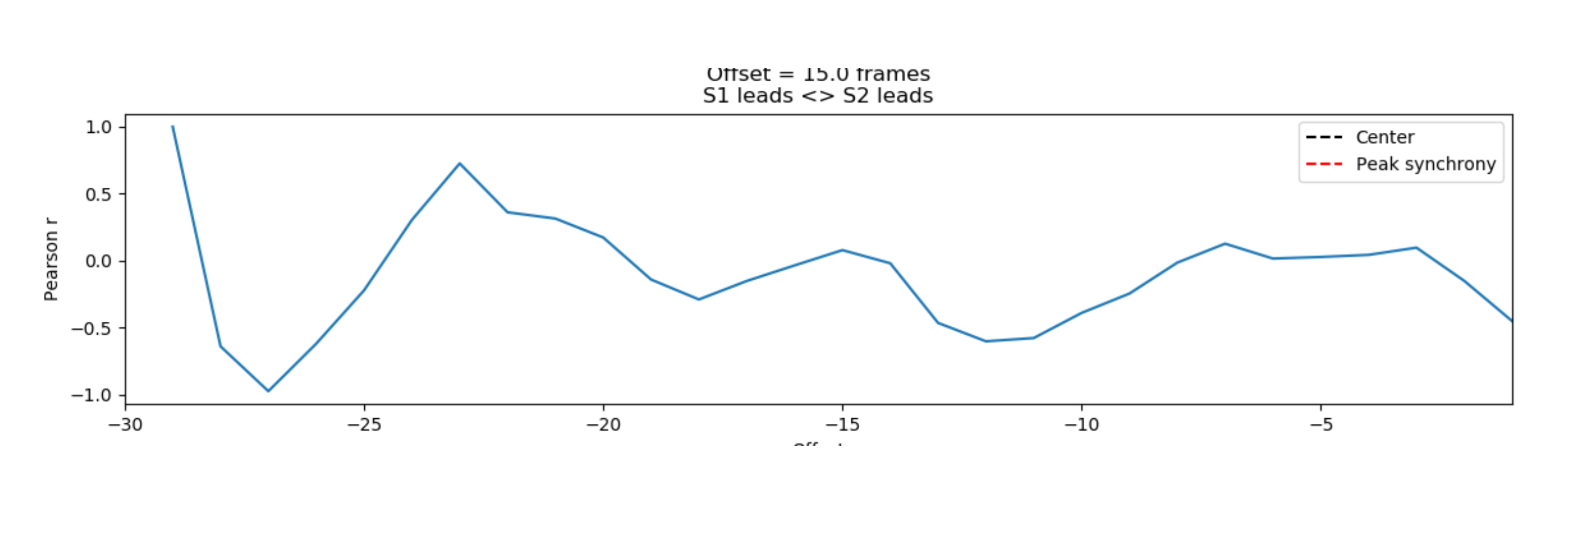

Slide 5
